Slide 1
Portland Trip Planner
Applied Data Science Capstone by IBM/Coursera

Slide 2
Introduction
Travel is an interesting and exciting experience.
Planning the trip on the other hand is time consuming or even stressful.
This project aims at making planning a trip easier and streamlining the process.
People who love traveling will benefit from the idea.

Slide 3
Data
We will take Portland, Oregon as the destination.
Attraction data will be from Google travel website.
Restaurant data will be from FourSquare

Slide 4
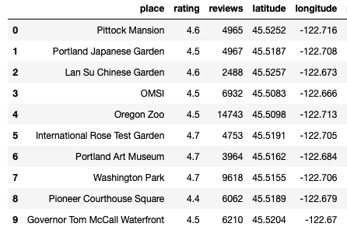
Dataframe of Attractions

Slide 5
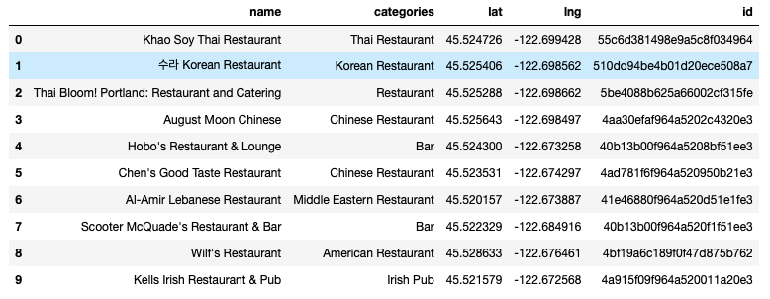
DataFrame of Restaurants

Slide 6
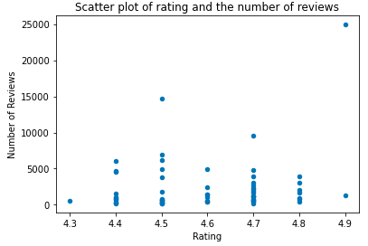
Analysis
Many attractions have the same rating.
But the number of reviews are in big discrepancy.

Slide 7
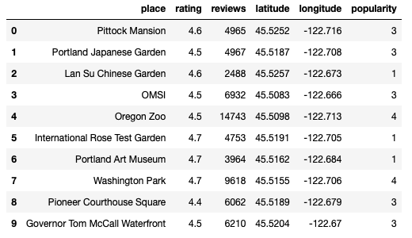
Methodology
Use K-Means cluster to combine rating and the number of reviews generating 5 labels of popularity.

Slide 8
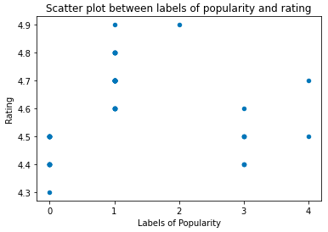
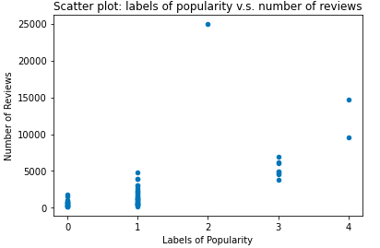
Result - K-Mean Labels
Label 0: low rating and low number of reviews
Label 1: higher rating but lower number of reviews
Label 2: very high rating and very high number of reviews
Label 3: lower rating but higher number of reviews
Label 4: average rating but high number of reviews

Slide 9
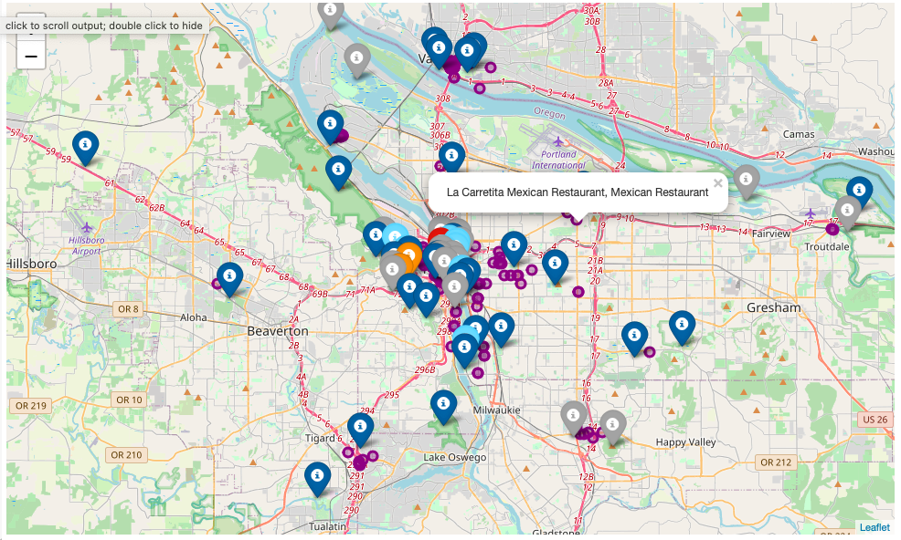
Result - Folium Map

Slide 10
Discussion
Attractions of label 2 is the first choice.
Attractions of label 0 can be skipped firstly if needed.
Attractions of label 4 is the second choices.
Attractions between label 1 and label 3 are hard to choose.

Slide 11
Conclusion
Labels of popularity can help pick attractions from a long list.
A map showing both attractions and nearby restaurants really saves time from collecting data online.
To-see, to-eat and geographical location are integrated on a map is very neat.

